Slide 1
Trade Track
4th April 2023
Notes:
Hello!

Slide 2
Overview
Introduction
Purpose and Opportunity
Industry
Stakeholders
Project Description
Project Planning
Implementation
Future Updates
Notes:
Talk about the points on the screen – we’ll go through

Slide 3
Introduction

Slide 4
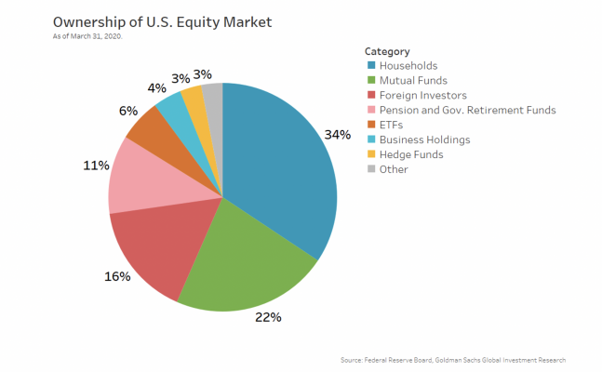
Context
“Most Traders/Retail Investors lose money because they don’t have a plan” – Forbes
Notes:
Households = 34% of traders on the NASDAQ one of the biggest stock markets in the world but a lot of retail investors lose money and a lot of this is because they don’t have a plan – I’ve been in to trading and investing the last 5 years and I’ve spent hours backtesting different strategies and I wanted to build something I would use myself and so I came up with idea Trade Track.
If you have investments on commsec you can clearly see your portfolio and actively trade but what if you’re using multiple brokers? Which I do. So I wanted a centralised web app where I can log both my real investments but then also will be useful for quickly adding up my results and giving me visual data on how my performance is going.

Slide 5
Purpose
Track trades and investments
Help plan
Easy to use
Calculations made easy
Notes:
Calculates quickly rather than me sitting there adding up all these items

Slide 6
Industry Background
Domination from Global Banks
34% of NASDAQ investors are household (retail) investors of which on average 74% lose money each year – due to lack of knowledge, lack of a plan and they don’t keep records of their trades.
The ages of 18-26 are the most critical years to think about retirement investments
If two people invest $100 a month for retirement, but one starts at 25 and the other starts at 35, the early investor will have nearly twice as much in their bank account by age 65.
Notes:
When we think of investing we think of Global Banks many of whom are struggling at the moment but household investors make up a large proportion of traders as we saw on slide 1 and many (up to 74% in a lot of cases) are losing money – some of this is lack of knowledge, lack of a plan and because they don’t actively keep track of their past performance.
Critical years

Slide 7
Stakeholders
Retail traders and investors
Finance Industry
Retirement Funds (Superannuation)
Notes:
So who could potentially use this app:
People like you and I – retail investors and traders
Those working in the finance industry
Superannuation funds

Slide 8
Product Description

Slide 9
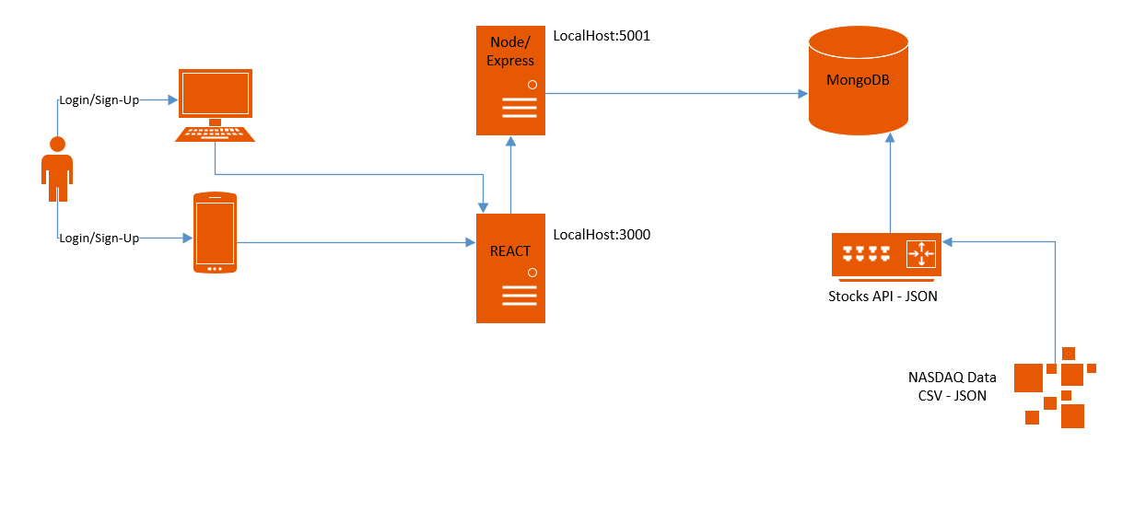
Architecture Diagram
Notes:
User can login or sign up
Frontend done in react
Backend uses node and express with mongodb for the databases
The API is an interesting one – there are lots out there but I couldn’t find one that just gave me the list of all the stocks I want to add to like an inventory for the user to choose – maybe I didn’t look hard enough but I decided to just make my own API and then add it to mongo db
So I downloaded the data from the NASDAQ website and then converted that from a csv file into a JSON and then used the insert many function with mongoose to chuck them all into my database.
This has the advantage that I have all the NASDAQ and NYSE stocks – over 7500 of them – which includes not only US stocks but stocks from around the world. But the disadvantage that it relies on me (at the moment) to manually download the csv and upload it as a JSON file. There is an API I want to use to get live trade data but I’m still working on this part and it’s not necessarily necessary for me to record my backtesting. So maybe when I get my big investor for this website they can help fund me to use a professional API.

Slide 10
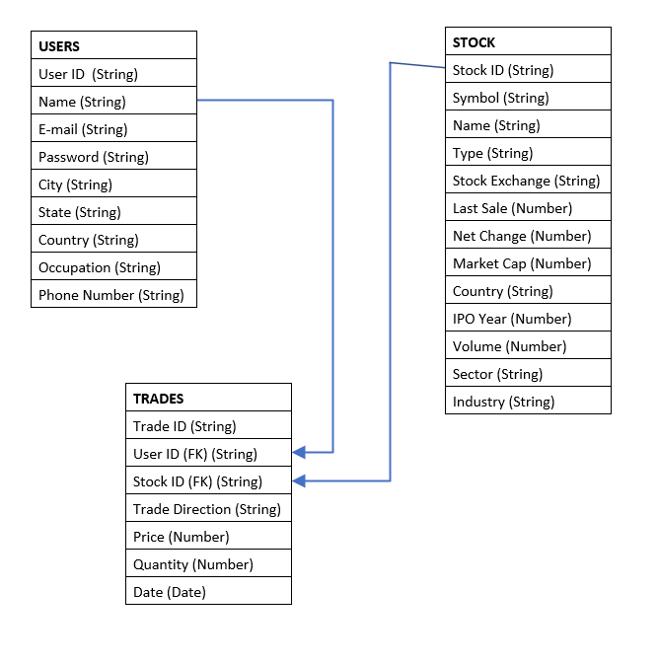
Database Diagram

Slide 11
User Stories Retail Investors/Traders
# | User Story Title | User Story Description | Priority | Comments
1 | Register/Sign-Up | If I need to sign up to use the product, it should be easy to follow and contain relevant data fields | 1 | Widely used Sign-Up/Login form – familiar to Users
2 | Investments | I want to be able to add all of my investments to the site | 2 | App has an initial database of all NASDAQ and NYSE stocks – over 7500 options
3 | Investment not there | My investment is on another Stock Exchange other than the NASDAQ/NYSE | 3 | Easy to use form that enables users to add their investment options
4 | Save Investments and see both active and closed | I want to be able to save my investments and differentiate between active and closed investments and trades | 4 | Investments for each user saved to a database and displayed through front-end
5 | Calculation/Total | I want to see the current value of my investments for both Buy and Sell positions as well as the total of my active and closed trades/investments | 5 | Total of trades included in front-end display
6 | Data Visualisation | I want to see some graphs and use other data visualisation tools to understand how my investments are performing, with a dashboard included | 6 | Beginning of this feature has been included – more to come in future versions.

Slide 12
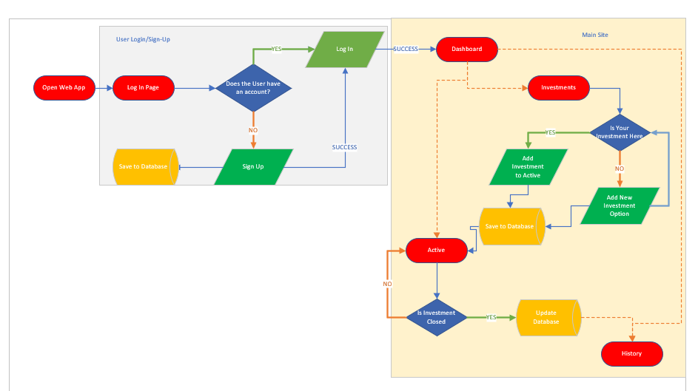
User Stories & Flow
Notes:
Split into two kind of designs – LogIn/Signup and then the main site with a nav bar etc.

Slide 13
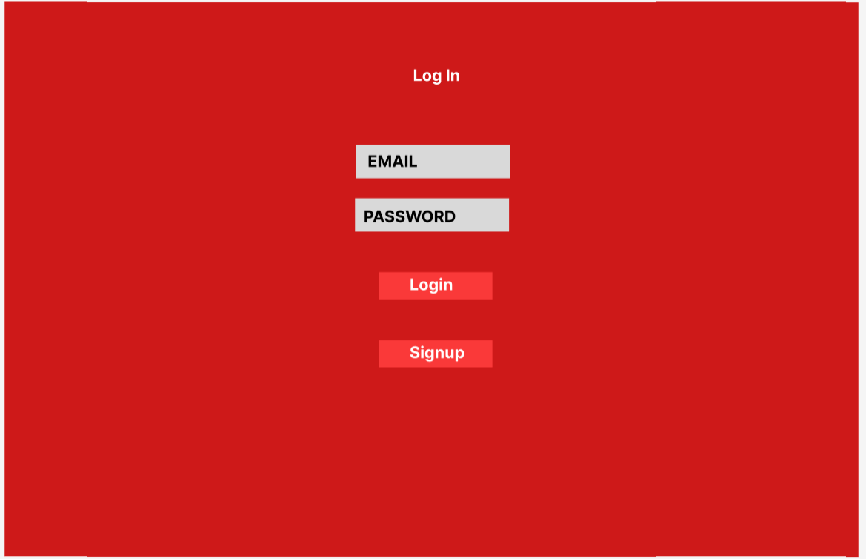
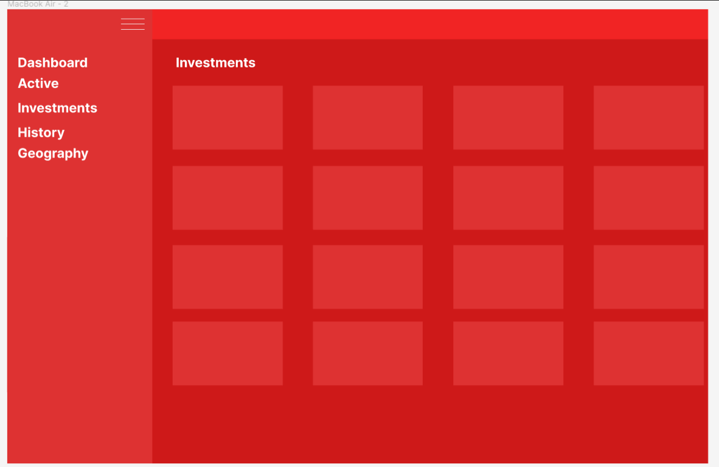
Design
Figma – Dashboard

Slide 14
Other Requirements Non-functional requirements
Security – Login to see your investments (Future: Session Timeout and Password Encryption
Easy to use
Responsive
Organisation – MVC Structure, Separated Front-End and Back-End, GitHub

Slide 15
Project Planning
Initial Idea – Requirements – Design in Figma
Build base Front-End design dashboard shell
Back-End functions and API implementation
Testing of functionality
Ready to use version
Future Versions

Slide 16
Implementation
Responsive Design
GitHub Repo – easy to install dependencies and run both Front-End and Back-End simultaneously – README instructions to do this.
Future Versions:
Auto update of share prices/live prices
Docker
Hosting – AWS, EC2
Data Visualisation

Slide 17
Application Review

Slide 18






Core Technology Used

Slide 19




API Source

Slide 20

Demonstration

